Slide 1
MRA Project - Milestone 1
CONTENTS:
Project Description/Agenda
Problem Statement
Data Dictionary
About Data
Univariate Analysis
Bivariate Analysis
Multivariate Analysis

Slide 2
PROJECT DESCRIPTION
This project aims to find the underlying buying patterns of the customers of an automobile part manufacturer based on the past 3 years of the company's transaction data and hence recommend customized marketing strategies for different segments of customers.

Slide 3
Problem Statement
An automobile parts manufacturing company has collected data of transactions for 3 years. They do not have any in-house data science team, thus they have hired you as their consultant. Your job is to use your magical data science skills to provide them with suitable insights about their data and their customers.

Slide 4
Data Dictionary
ORDERNUMBER : Order Number
CUSTOMERNAME :customer
QUANTITYORDERED :Quantity ordered
PHONE :Phone of the customer
PRICEEACH :Price of Each item
ADDRESSLINE1 :Address of customer
ORDERLINENUMBER :order line
CITY :City of customer
SALES :Sales amount
POSTALCODE :Postal Code of customer
ORDERDATE :Order Date
COUNTRY :Country customer
DAYS_SINCE_LASTORDER :Days_ Since_Lastorder
CONTACTLASTNAME :Contact person customer
STATUS :Status of order like Shipped or not
CONTACTFIRSTNAME :Contact person customer
PRODUCTLINE :Product line – CATEGORY
DEALSIZE :Size of the deal based on Quantity and Item Price
MSRP :Manufacturer's Suggested Retail Price
PRODUCTCODE :Code of Product

Slide 5
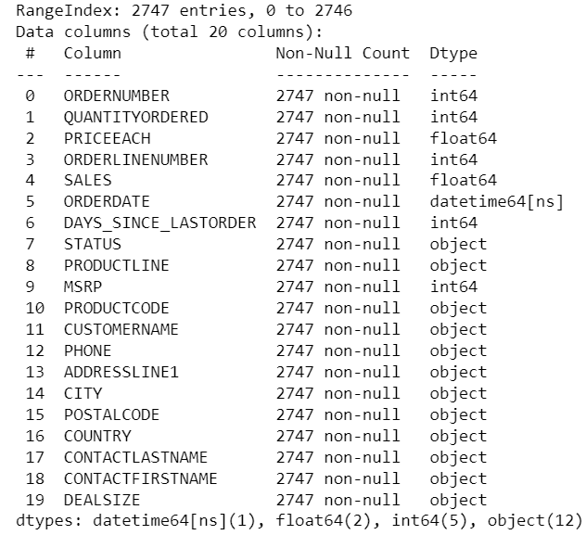
ABOUT DATA
Info: Data consists of total 2747 entries, with zero null values.
Shape: Data has 2747 Rows and 20 Columns.
Data Types: It has 1 column of ‘datetime64[ns]’ data type, 2 columns of ‘float64’, 5 columns of ‘int64’ and 12 columns of ‘object’ data type.

Slide 6
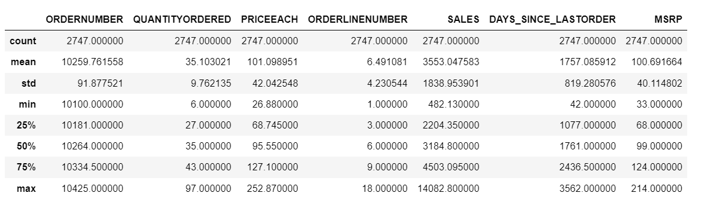
Summary Stats: Min Sales- 482.13, Max Sales-14082.80, Mean of Sales- 3553.04
Max. price of item- 252.87 & Min. price of item- 26.88 with standard deviation of 42.04
Min. no. of days since last order- 42 days, Max. no. of days since last order-3562 days.
Assumptions: At first glance over the summary of the data, it seems like the items are not too costly, the average price of each item is 101.09. The difference between the max and min ordered quantity is too high, and the standard deviation(9.76) is very less, it means there are vey few customers who ordered higher quantities than others. Also, the average of MSRP is coming out to be 100.69, that isn’t very high. We need to focus here on few things mainly like ‘Sales’ and ‘Days since last order’.

Slide 7
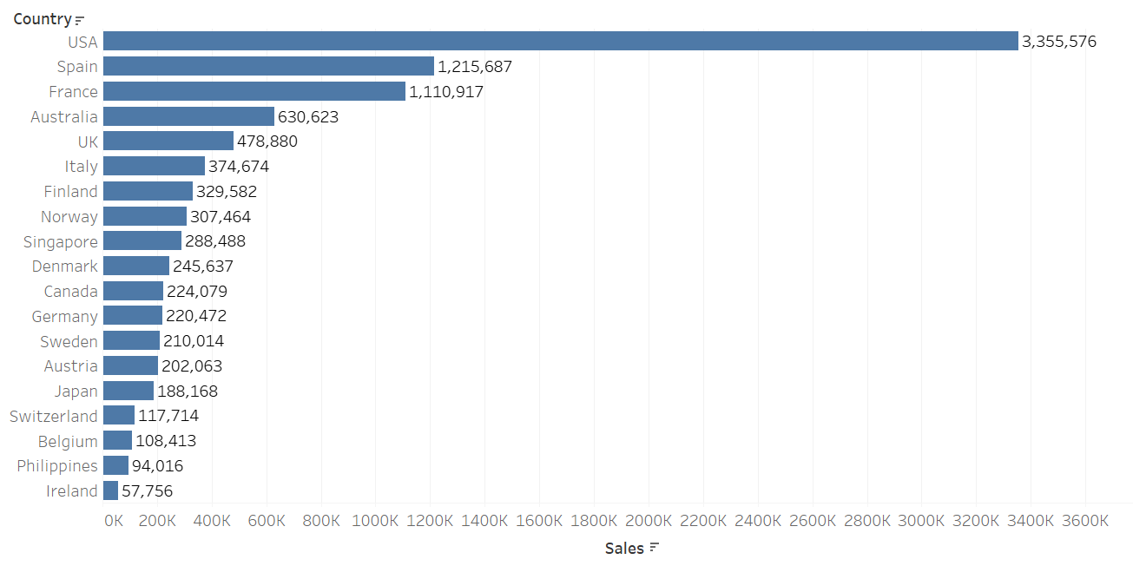
Univariate, BIVARIATE and MULTIVARIATE Analysis
1) COUNTRY: Let’s first look at the count plot for the COUNTRY.
Out of total 19 countries in the dataset, It seems like USA clearly wins the game here. The maximum number of sales is coming from USA and the minimum number of sales are here from Ireland.

Slide 8
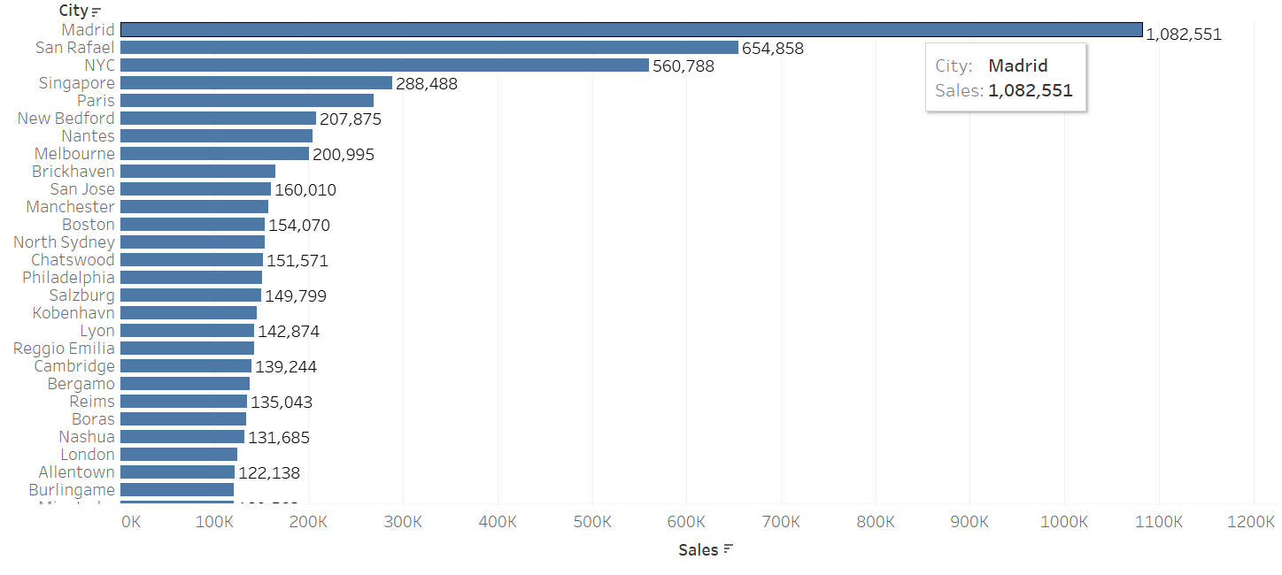
2) CITY: Here we can see that the city ‘Madrid’ has max no. of sales.

Slide 9
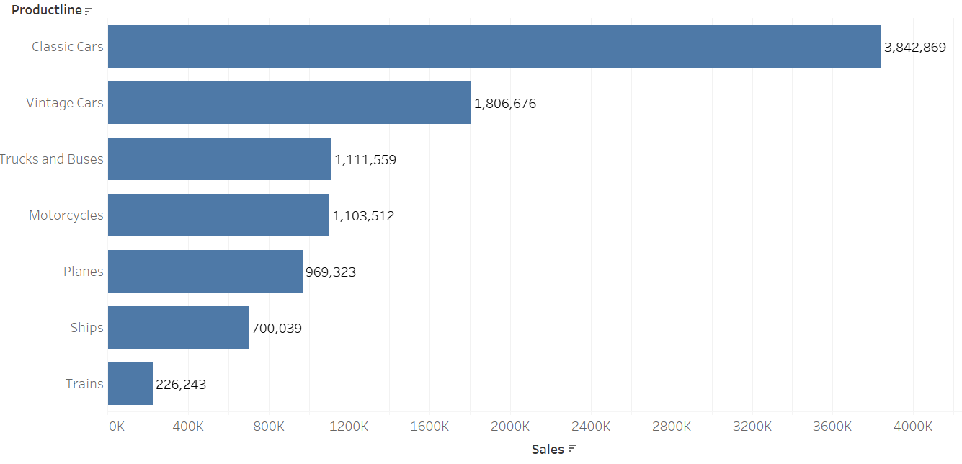
3) PRODUCT LINE- We can clearly see that Classic Cars has the max no. of sales, (above 4000) followed by Vintage Cars. While Trains has the least no. of sales.

Slide 10
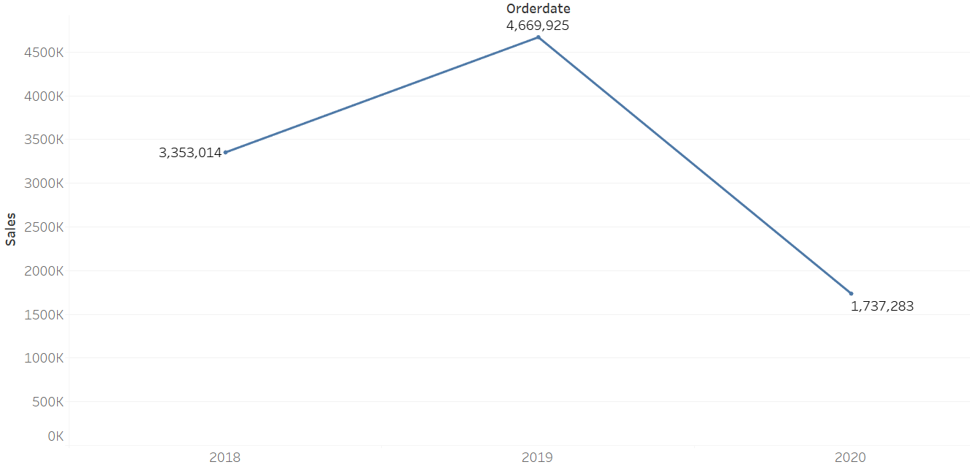
Yearly Trend in Sales

Slide 11
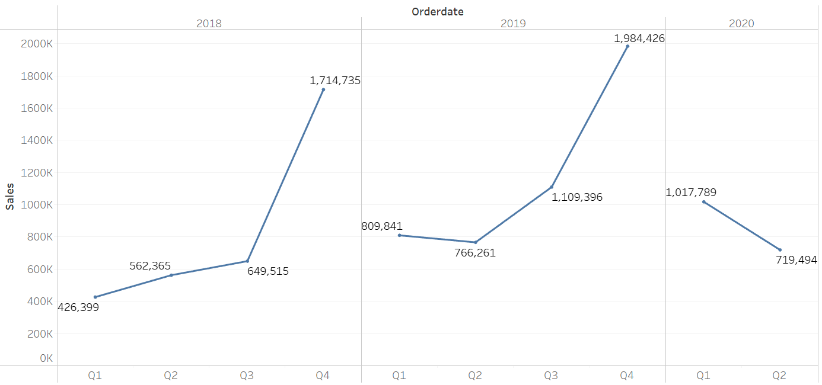
Quarterly Trend in sales

Slide 12
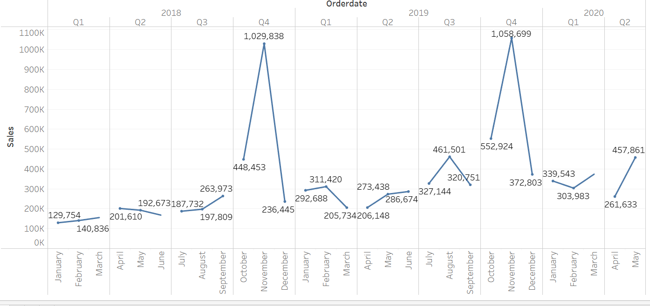
Monthly trend in sales

Slide 13
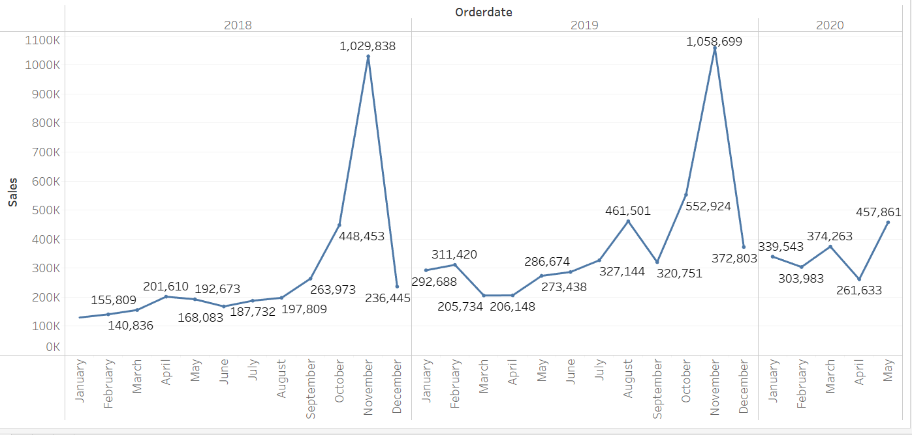
Yearly and monthly trends

Slide 14
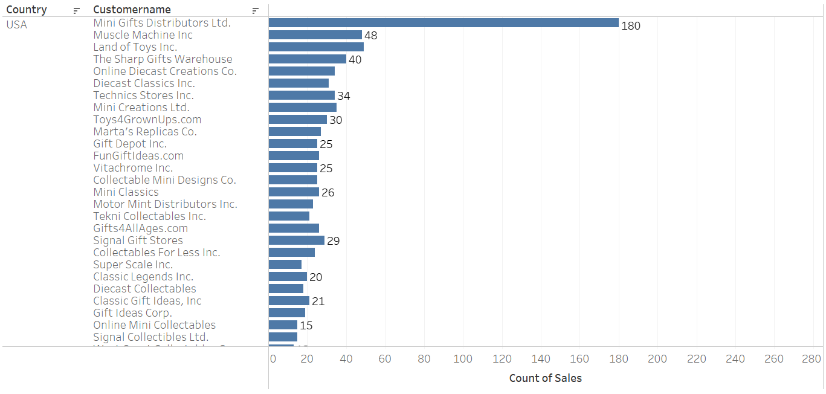
TOP Customers from usa

Slide 15
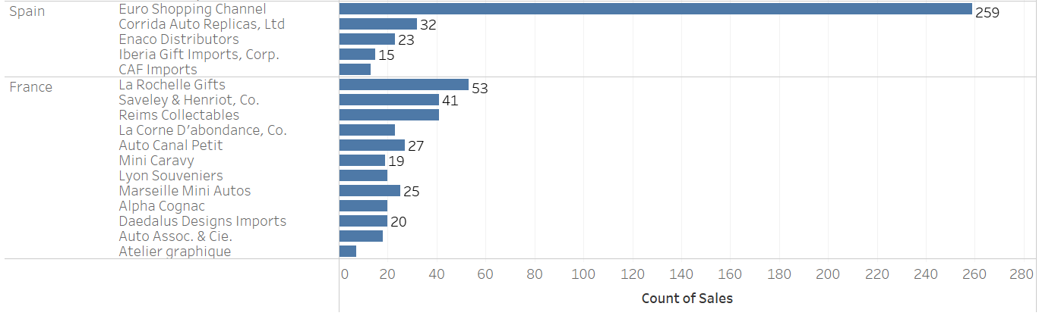
TOP customers from Spain and France

